Slide 1
Operating system and system programming (25CS2104E)
Linux File System Explorer System Calls
Review-I
Team Members:
Sindhuja 2520080045
Jhanasri 2520090121
Alekhya 2520090126
Under the Esteemed Guidance of
Raghupathi M
CSE Department

Slide 2
Contents
Abstract
Introduction
Hardware and Software requirements
System Architecture
Conclusion

Slide 3
Abstract
The Linux File System Explorer is a simple project developed to help users perform basic file and directory operations in a Linux environment. It provides an easy way to manage files using a command-line interface. The system allows users to create new files and directories, read and write data, view information about files, and delete files when they are no longer needed. These operations are performed using Linux system calls, which allow the program to communicate with the operating system. The project helps us understand how Linux manages files and directories and how applications interact with the operating system. It also provides practical knowledge about file handling, file input/output, file descriptors, directories, and system programming. Overall, this project gives a basic understanding of the Linux file system and the role of system calls in performing file-related operations.

Slide 4
Introduction
The Linux File System Explorer is a simple application designed to perform basic file and directory operations in Linux. A file system is used by the operating system to store and organize files and folders. In this project, users can easily create, read, write, and delete files and directories. The application uses Linux system calls to perform these operations and communicate with the operating system. It helps us understand how files are managed in Linux and how a user program interacts with the Linux kernel. The project also gives practical knowledge about file handling, file input/output, directories, file descriptors, and system programming.

Slide 5
Hardware and Software requirements
Hardware | Requirement
Processor | Intel Core i3 or above
RAM | 4 GB or above
Storage | 10 GB free space
Software | Requirement
Operating System | Linux / Ubuntu
Programming Language | C
Compiler | GCC
Interface | Command Line Interface (CLI)
APIs | Linux/POSIX System Calls
Development Tool | VS Code / Linux Terminal

Slide 6
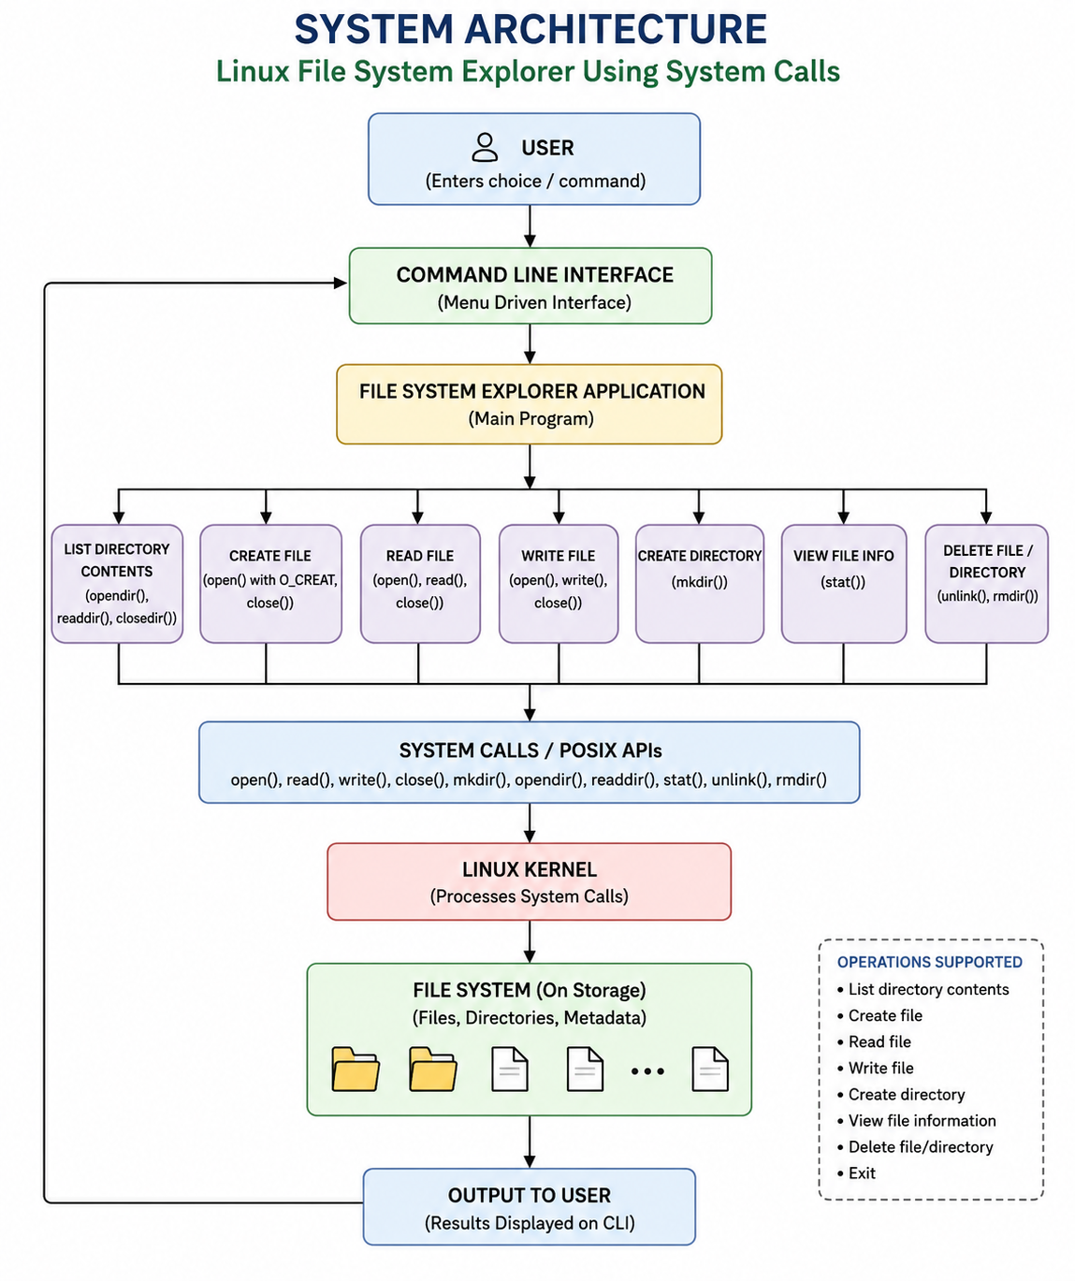
System Architecture

Slide 7
Thank you

